Slide 1
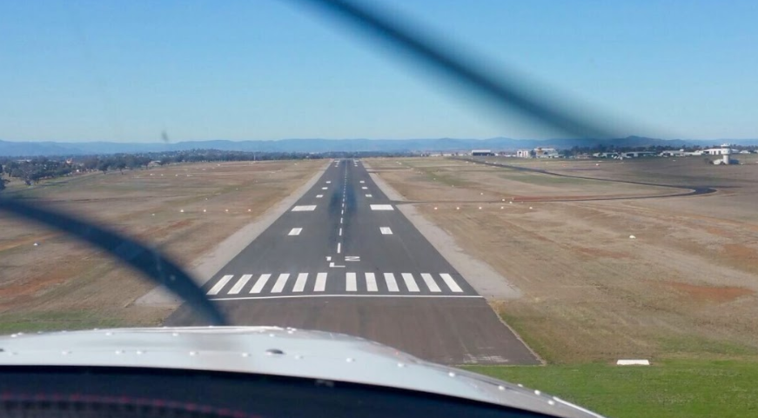
CIRCUITS

Slide 2
OVERVIEW
Aim
Objectives
Revision
Definitions
What is a Circuit?
Factors affecting Take-Off
Factors affecting Landing
Local Procedures
Application
Airmanship
T.E.M
Revision Questions

Slide 3
AIM
To take-off, fly the circuit pattern and land the plane safely as well as joining the circuit at any legs.

Slide 4
OBJECTIVES
Identify the circuit legs.
State the correct downwind checks.
State the correct procedure for take-off and for landing.
Describe the actions to take if you conduct a Go-Around.
State the effect of headwind on take-off and landing.

Slide 5
REVISION
State the work cycles for different manoeuvres we carried out in the training area (instructor discretion)

Slide 6
DEFINITION
Maximum Take-off Weight: The maximum weight that an aircraft is certified to take-off with (SLG2 600KG).
Take-off Distance Available (TODA): The distance available including runway and clearway.
Take-off Distance Required (TODR): The distance required for the aircraft to take-off and climb to 50 feet AGL.
Vr (Rotate Speed): The speed where you pull back on the elevator to get airborne.
SLG2 has a Vr of 55 kts

Slide 7
DEFINITIONS
Touch & Go:
Landing the airplane and applying power straight away for a take-off without stopping.
Aim Point:
A point on the runway selected during approach used to judge a stable flight path down to the runway.
Approach safety speed - 1.3Vs:
This is the minimum approach speed to be used until 50ft above the runway.
Landing distance required (LDR):
The distance required for an airplane to come to a complete stop on the runway after crossing the threshold at 50ft.
Landing distance available (LDA):
The length of runway available and suitable for the ground roll of an aircraft landing.
Go-Around:
A procedure for discontinuing an approach if the approach is unstable or a safe landing is compromised.

Slide 8
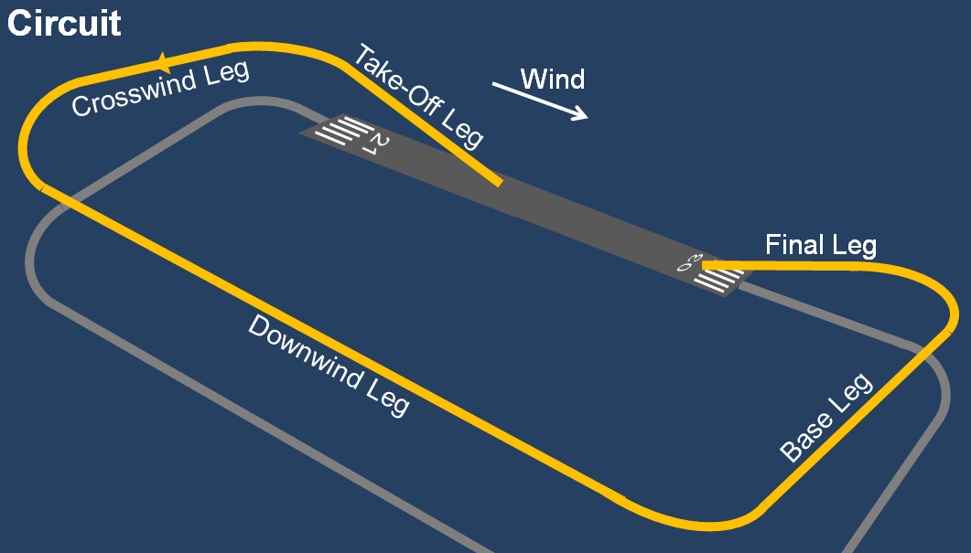
CIRCUIT
Definition
Forms a rectangular-like pattern around the designated runway.
Provides a safe and orderly queue for traffic to operate.
Positions the aircraft for an approach to land.
Standard circuit direction is LEFT unless stated otherwise .

Slide 9
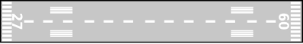
CIRCUIT PATTERN
Definition
Downwind
Base
Live Side
Crosswind
Final
Upwind
Dead Side

Slide 10
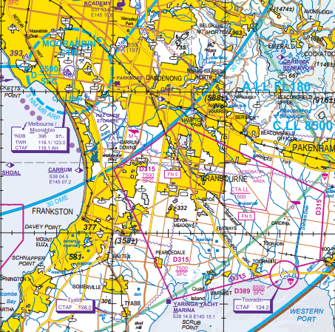
Definition
YMMB
YTDN

Slide 11
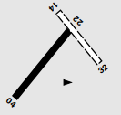
TOORADDIN (YTDN)
Definition

Slide 12
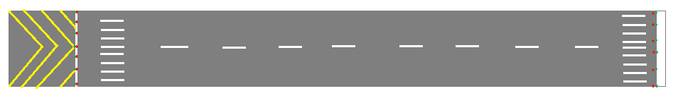
TOORADDIN (YTDN)
Definition
04
22

Slide 13
TOORADDIN (YTDN)
Definition
04
22

Slide 14
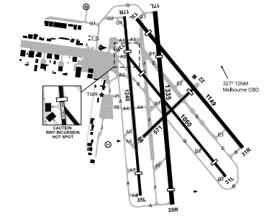
MOORABBIN (YMMB)
Definition

Slide 15
MOORABBIN (YMMB)
Definition
Runway 35
17L
35R
17R
35L

Slide 16
MOORABBIN (YMMB)
Definition
Runway 17
17L
35R
17R
35L

Slide 17
MOORABBIN (YMMB)
Definition
Runway 31
13L
31R
13R
31L

Slide 18
MOORABBIN (YMMB)
Definition
Runway 13
13L
31R
13R
31L

Slide 19
FACTORS AFFECTING TAKE-OFF

Slide 20
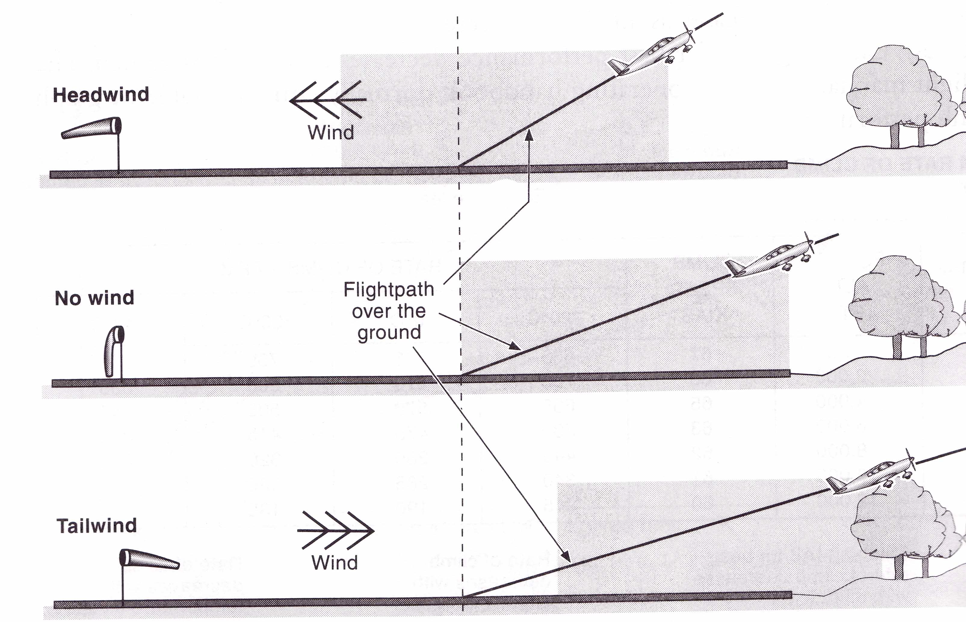
Factors
FACTORS AFFECTING TAKE-OFF
Wind:
Under normal conditions, we always take off with a HEADWIND.
Headwind generates some lift, which reduces take-off distance required.
We have a better Angle of Climb.
We have a lower Groundspeed.

Slide 21
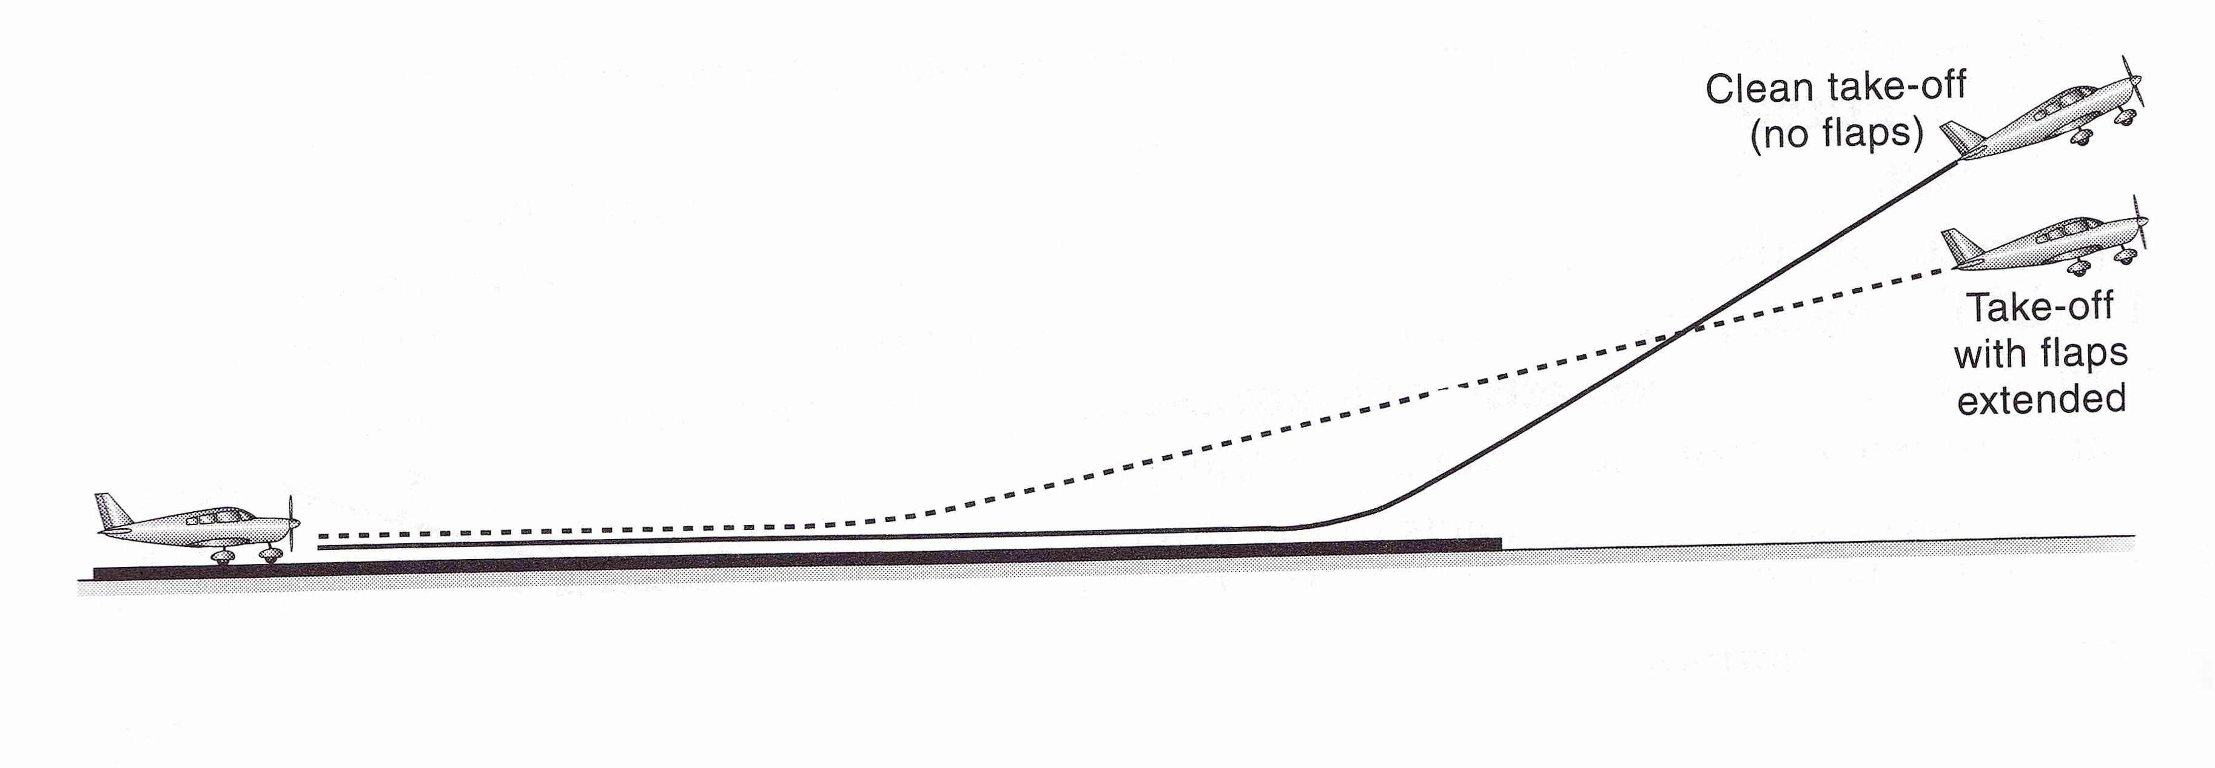
Factors
WEIGHT:
An increase in weight will decrease the acceleration rate of the aircraft.
This will take longer to reach VTOSS.
Thus TODR will increase.
FLAP:
Used in take-off to produce a large lift force with an additional small drag force.
Reduces take off distance required, however reduces both angle of climb and rate of climb.

Slide 22
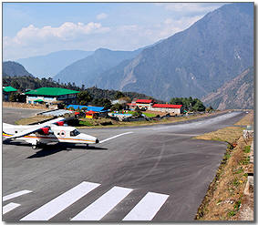
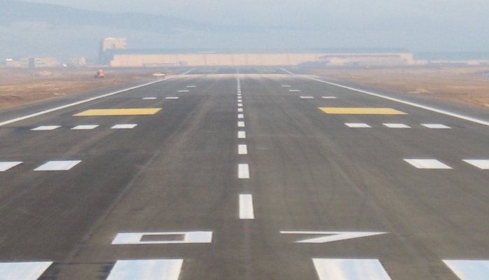
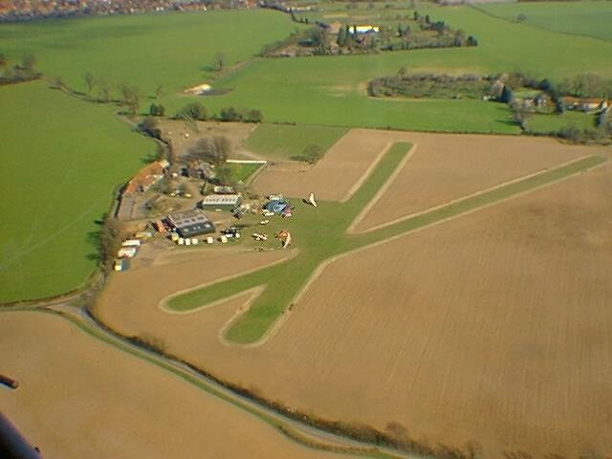
Factors
SLOPE/SURFACE:
Downslope will reduce time to speed up to VTOSS and thus TODR.
Hard surfaces will reduce TODR, due to more grip from the tyres.

Slide 23
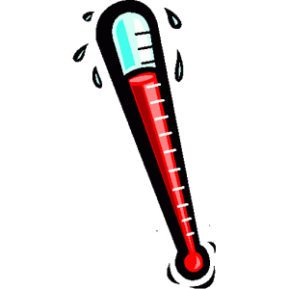
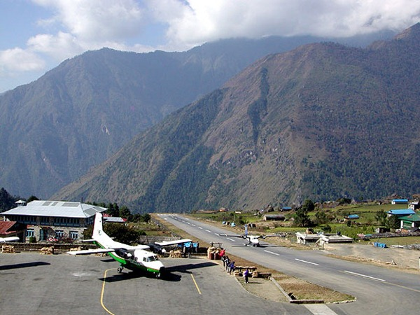
Factors
DENSITY ALTITUDE:
Increase in density altitude decreases density of air.
Engine cannot draw in enough volume of air to produce thrust to overcome drag.
Acceleration to VTOSS is less thus more TODR is required.

Slide 24
Factors
SUMMARY
FACTOR | TAKEOFF DISTANCE REQUIRED
HEADWIND
INCREASED WEIGHT
EXTENDING FLAPS
DOWNSLOPE
HARD SURFACE
HIGHER DENSITY ATTITUDE

Slide 25
FACTORS AFFECTING LANDING

Slide 26
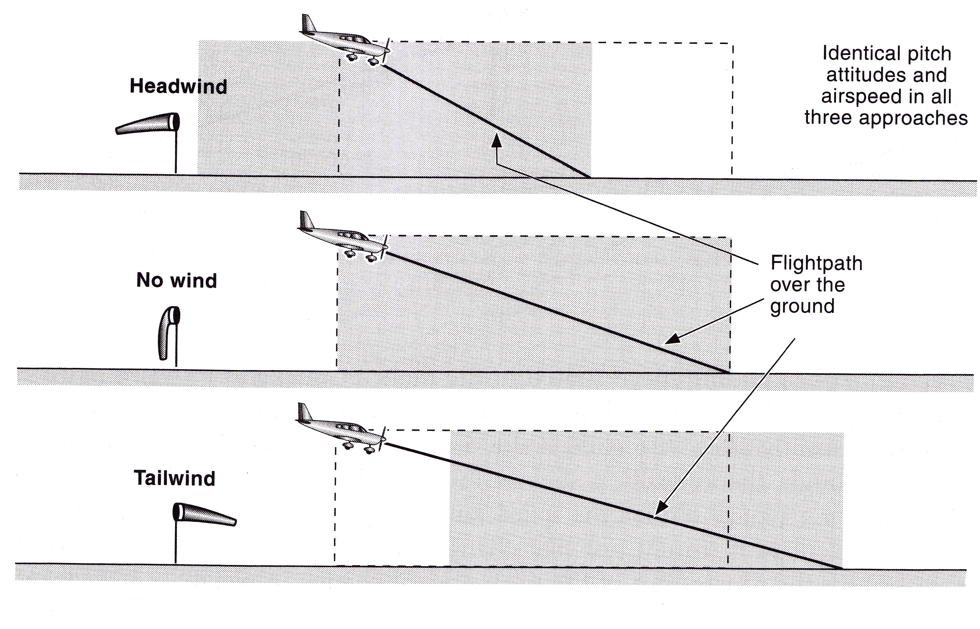
Factors
FACTORS AFFECTING LANDING
WIND:
ALWAYS LAND INTO A HEADWIND.
Headwind decreases the groundspeed, thus decreases LDR.
Increases angle of descent which allows better obstacle clearance.

Slide 27
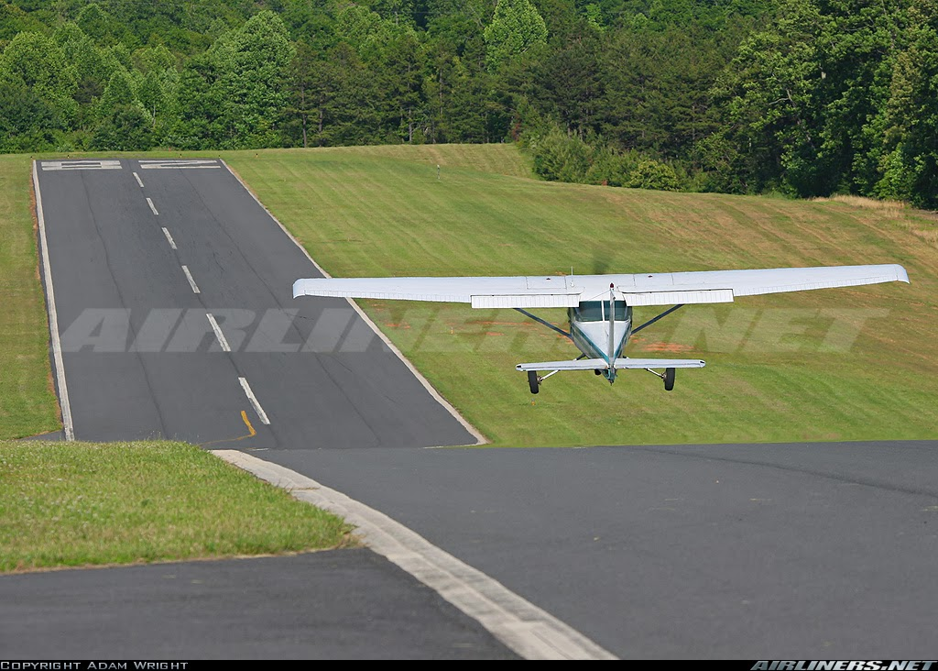
Factors
WEIGHT:
The heavier the object the more inertia it carries upon landing.
Increased weight increases the stall speed which must result in an increase in approach safety speed.
This will result in an increased LDR.
SLOPE:
A downslope will increase LDR, because it is harder to slow down.

Slide 28
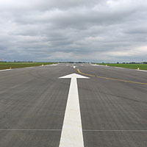
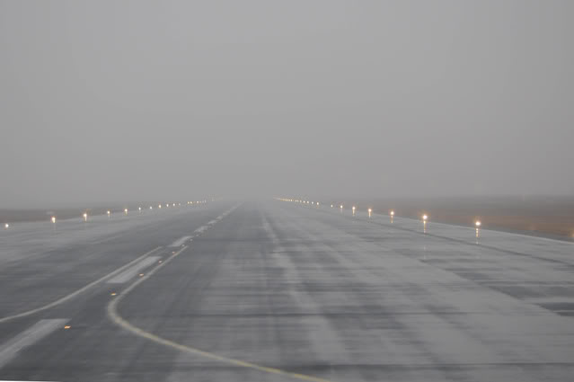
Factors
SURFACE:
A dry runway is preferable because of the rough surface allows grip.
A wet or frozen runway becomes slippery which reduces friction, increasing LDR.

Slide 29
Factors
FLAPS:
Extend for better forward visibility on landing.
Increases angle of descent.
Lower stall speed which results in a lower approach safety speed.
Increase Drag.
This results in a decreased LDR.

Slide 30
SUMMARY
Factors
FACTOR | EFFECT ON LDR
Headwind
Increased Weight
Downslope
Wet Surface
Flaps

Slide 31
APPLICATION

Slide 32
STARTUP/BEFORE TAKEOFF
Application
Start-Up:
Listen to ATIS (120.9).
Request start-up clearance.
“Moorabbin Ground, Sling 8786, request start for circuits.”
Taxi & Run-up:
Follow the checklists and carry out the required checks.
Request taxi clearance at Runup Bay.
“Moorabbin Ground, Sling 8786, in the Southern Run-up Bay, with (ATIS), request taxi to (runway) for circuits, dual.”

Slide 33
TAKEOFF
Application
HOLDING POINT:
Carry out line-up checks.
Announce ready to tower.
“Moorabbin Tower, Sling 8786, Runway 35R, ready for circuits.”
“Cleared for take-off/hold position/line-up, UUD.”
Check for traffic on final.
Enter the runway, strobe lights on for entering runway.
Landing lights on when take-off clearance is received.

Slide 34
Application
TAKEOFF ROLL:
Full Power (3-5s).
Maintain centreline with RUDDER.
40 kts, speed is alive.
Oil T&P’s are in the GREEN.
Vr:
Accelerate to VTOSS (55 kts) (-0/+5kts)
Apply back pressure to raise the nose to the horizon.
Maintain centreline (Pick a reference point).

Slide 35
Circuit – Take-off
Downwind
Base
Crosswind
Final
Upwind
Flaps 1
Full Power
55kts, Rotate
Nose on the horizon
Trim

Slide 36
CIRCUIT - Upwind
Downwind
Base
Crosswind
Final
Upwind
300 ft
Brakes applied
Flaps up

Slide 37
CIRCUIT – Crosswind Turn
Downwind
Base
Crosswind
Final
Upwind
500ft
Lookout
Reference point
Climbing turn

Slide 38
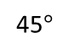
CIRCUIT – Downwind Turn
45 Deg from threshold
Lookout
Pick a reference point
Climb/Medium Turn
It’s a turning point, if you haven’t reach
1000 ft yet, turn first and level off on downwind.
Downwind
If you’ve reached 1000 ft,
level off with ASPT.
45$°$
Base
Crosswind
Final
Upwind

Slide 39
CIRCUIT - Downwind
Check Power
Check Altitude
Check Separation
“UUD, turning DW, touch and go.”
Downwind
Base
BOUMFAH
Crosswind
Final
Upwind

Slide 40
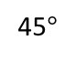
CIRCUIT – Base Turn
45 degrees from threshold
Lookout, pick reference point
Power 3300, hold ALT
Medium Level Turn
Check speed < 85kts
Flaps 2
Set ½ Ground, ½ Sky Attitude
Trim the back pressure
45$°$
Downwind
Base
Crosswind
Final
Upwind

Slide 41
CIRCUIT - Base
Mid base, check altitude 700-800
Check Profile
Check Airspeed
Adjust Power + Attitude to get the required Performance
Downwind
Base
Crosswind
Final
Upwind

Slide 42
CIRCUIT – Final Turn
Downwind
Not below 500 ft
Anticipate the final turn
Shallower angle of bank
No more than 30 AOB
Base
Crosswind
Final
Upwind

Slide 43
CIRCUIT – Final Approach
Downwind
Base
Crosswind
Final
Upwind
Aim Point, 4F with piano key
Aspect
Airspeed 70kts

Slide 44
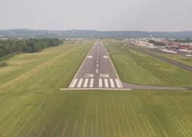
Application
FINAL TO LANDING
4 fingers

Slide 45
FLARE
Application
Approaching the threshold, slow down to 60 knots.
Once over the Threshold, IDLE the Throttle
Eyes to the end of the runway
Slowly raise the nose as the aircraft sinks.
End result should be nose to the horizon.
Stay strong on the controls after touch down.
BRAKE OR TOUCH AND GO AS REQUIRED
For TOUCH AND GO, retract flap to 1 stage and apply full power for take-off again

Slide 46
Application
GO AROUND
WE DO A GO-AROUND UNDER THE FOLLOWING CIRCUMSTANCES
ATC tells us to or doesn’t give us clearance to land,
Runway is not clear, eg. another aircraft, cow, kangaroo,
The approach to land is unstable,
BOUNCE ON THE RUNWAY
APPLICATION:
Apply full power
Set climb attitude
Check positive rate of climb, retract flaps in stages (above 300ft before flaps up)
Contact ATC
Climb to circuit altitude and turn crosswind at least after runway threshold and clear of traffic.

Slide 47
Local Procedures – Crosswind Turn for
RWY 17L
Downwind
Helicopters CCTs at 700ft
Base
Crosswind
Final
Upwind
Why?
500ft
Lookout
Reference point
Climbing turn
700ft

Slide 48
AIRMANSHIP/TEM
THREAT | ERROR | MANAGEMENT
Near Miss
No Lookout
Always do a lookout before turns
Descending before properly configuring the aircraft
Configure the aircraft before attempting a manoeuvre
Exceed flap speed
Letting the aircraft get past the stage of a safe go around
Rough Landing
Go Around if Unsafe

Slide 49
REVISION QUESTIONS
Identify the circuit legs.
State the correct downwind checks.
State the correct procedure for take-off and for landing.
Describe the actions to take if you conduct a Go-Around.
State the effect of headwind on take-off and landing.

